Slide 1
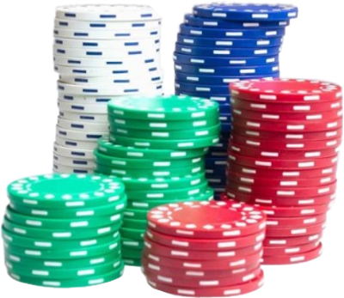
BLACKJACK PAYS 3 TO 2
Dealer must draw to
16 and stay on all 17’s
Double tap to HIT, Swipe right to STAY
$25
$50
$100
$250
$1K

Slide 2
PLAY AGAIN
$25
$50
$100
$250
$1K

Slide 3
LOSER
PLAY AGAIN
$25
$50
$100
$250
$1K

Slide 4
Blackjack!
PLAY AGAIN
$25
$50
$100
$250
$1K

Slide 5
WINNER!
PLAY AGAIN
$25
$50
$100
$250
$1K

Slide 6
Game
Over
START AGAIN
$25
$50
$100
$250
$1K

Slide 7
← START
CLEAR BET
$25
$50
$100
$250
$1K

Slide 8
GOOD LUCK
$25
$50
$100
$250
$1K

